Slide 1
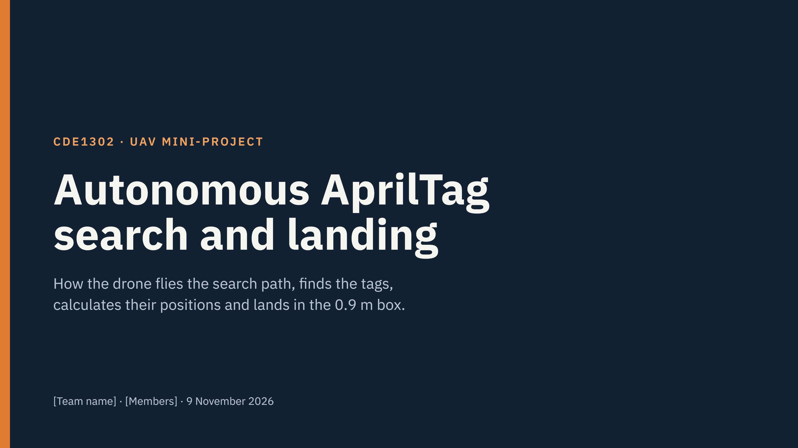
Team 5
Maxwell , Gayatri, Brycen, Akash
9 November 2026
Notes:
This presentation shows the full system. First, we show the architecture. Then we show each part, the transforms and the pose-graph optimisation. Last, we show the results and the limits.

Slide 2
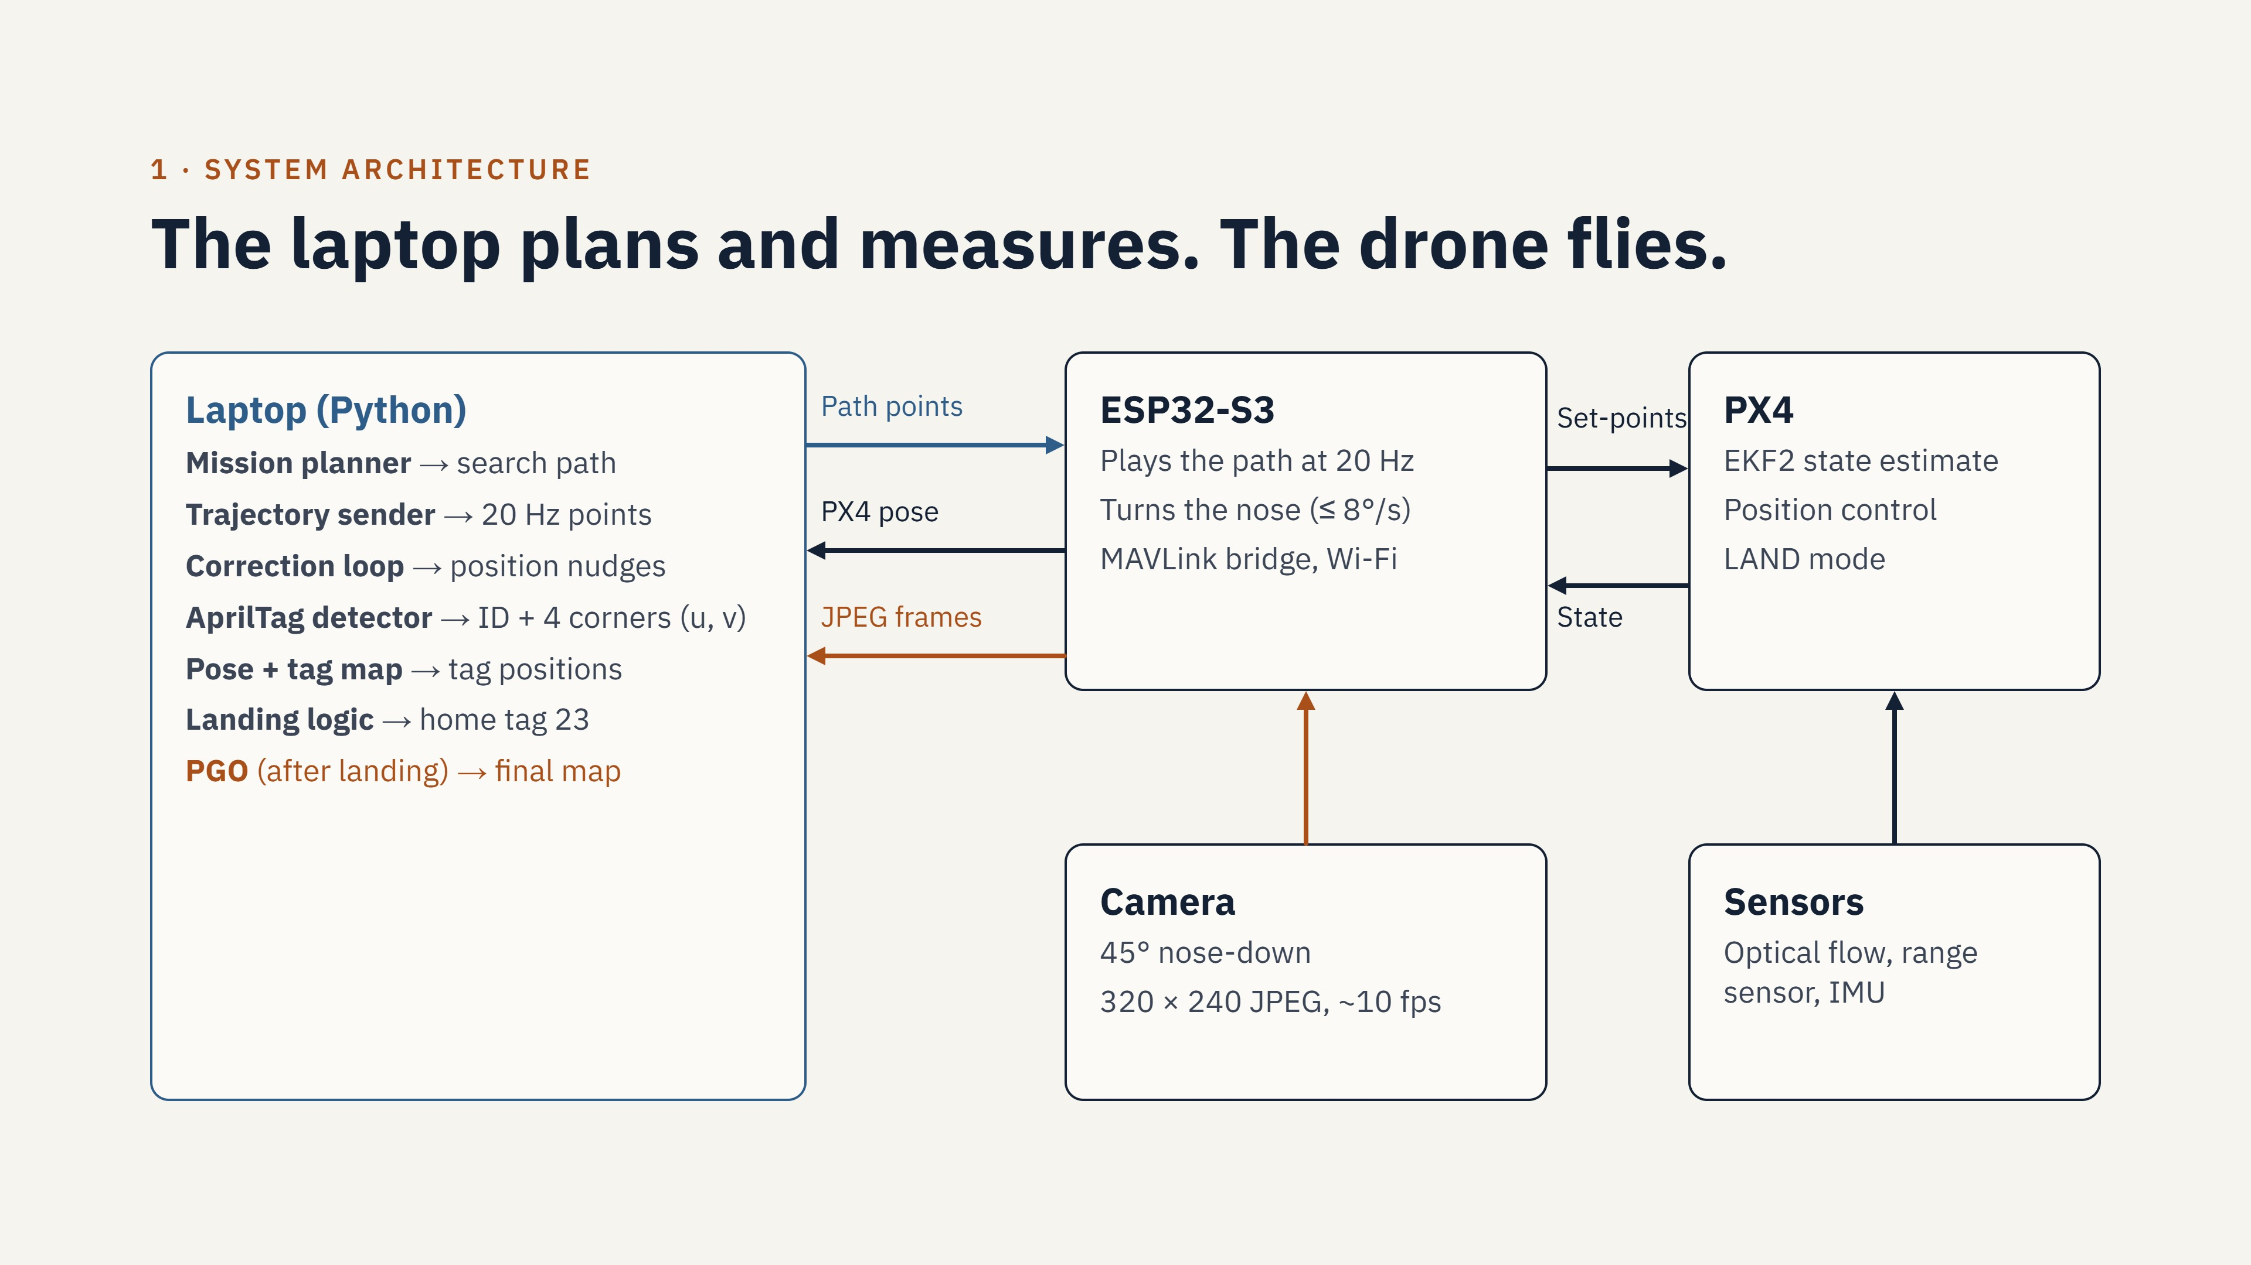
Notes:
The laptop does the planning and the measurement. The ESP32-S3 on the drone plays the path at 20 Hz. It sends position and velocity set-points to PX4 through MAVLink. PX4 uses the optical flow, the range sensor and the IMU to estimate the position. The camera sends JPEG frames through the ESP32-S3 to the laptop. The laptop detects the AprilTags. Each detection gives the tag ID and the 4 corner pixels. After the landing, the pose-graph optimisation (PGO) makes the final map.

Slide 3
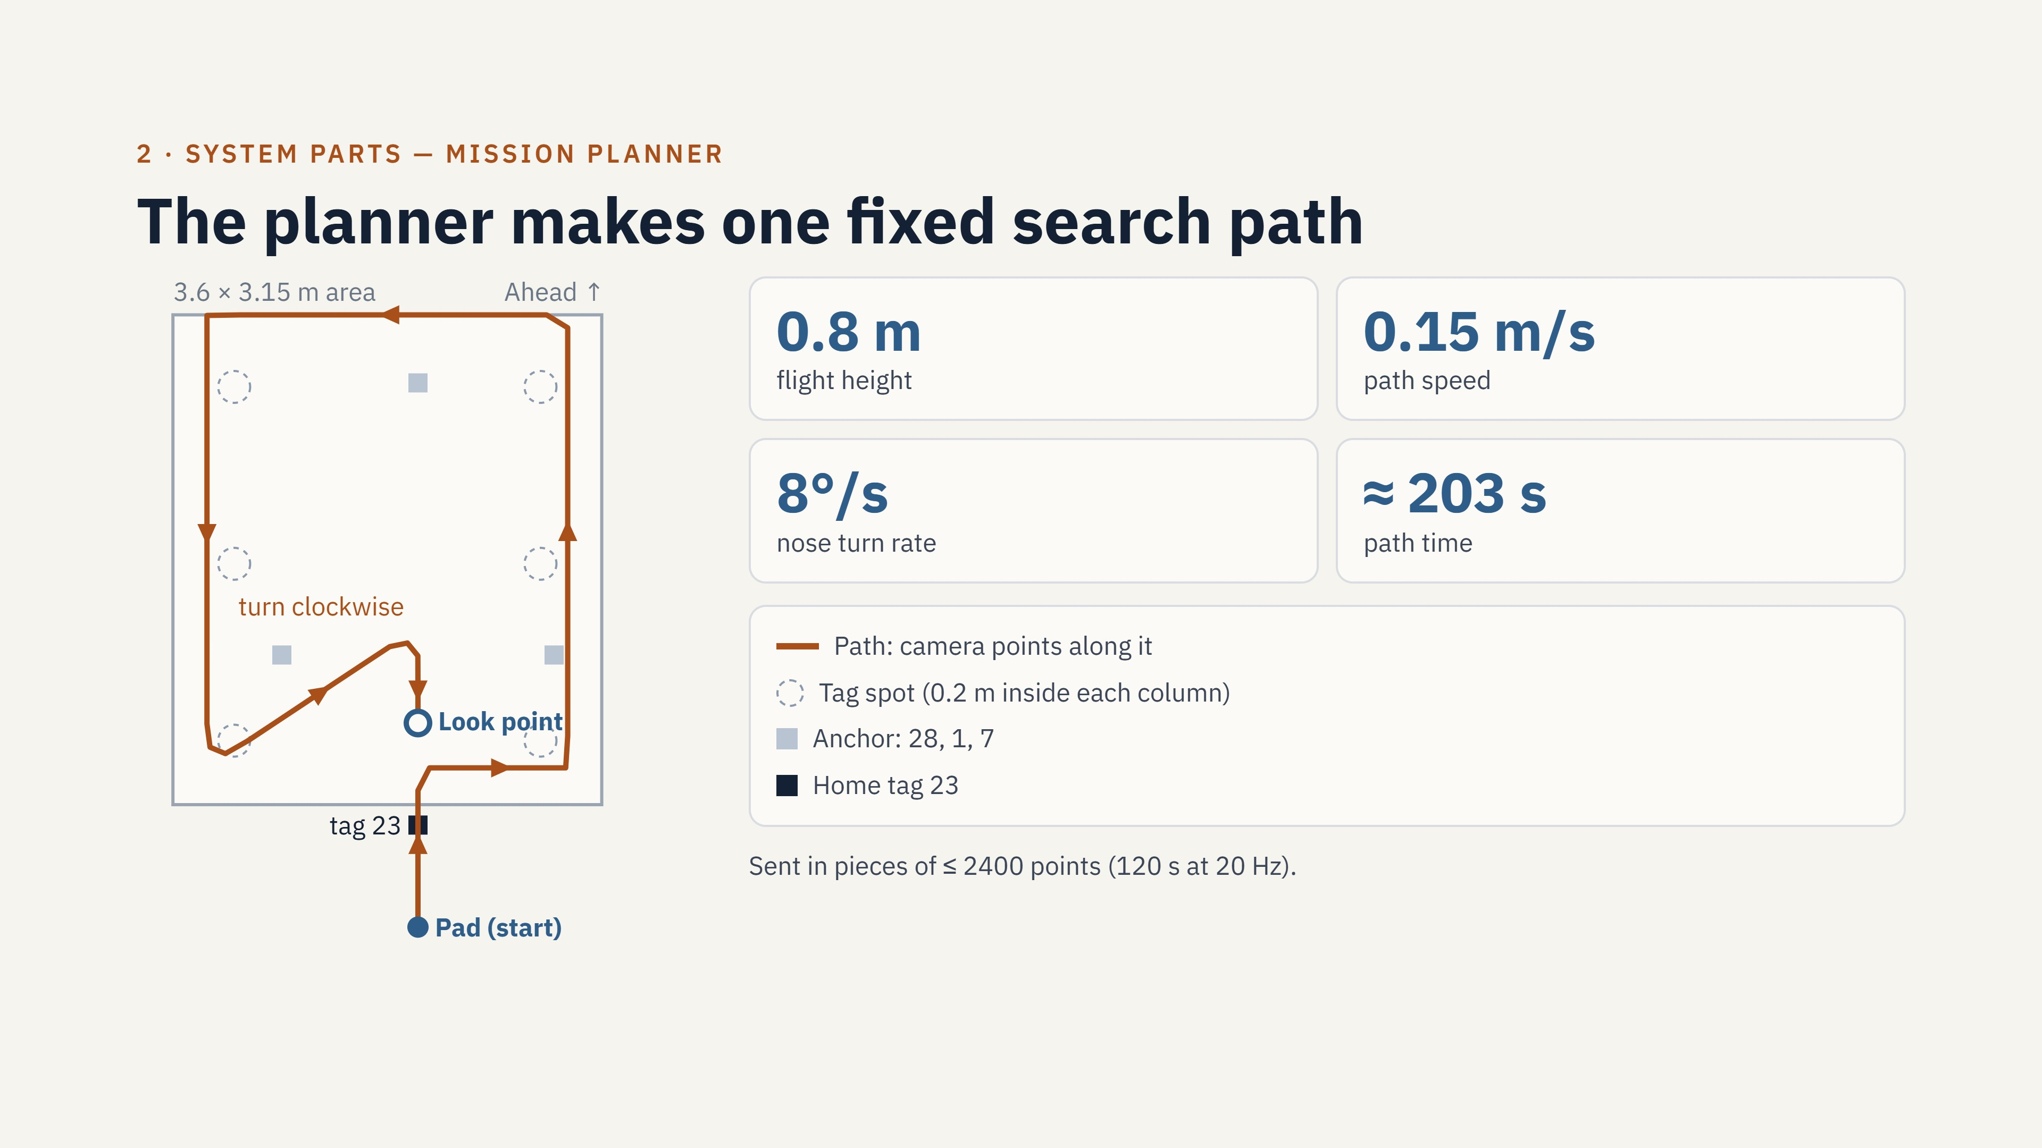
Notes:
The map shows the path from above. The drone takes off at the pad. It flies along the near row, up the right column, across the top line and down the left column. Then it flies a diagonal and turns clockwise at the apex. It stops at the look point and faces home tag 23. The path is fixed. We do not use the tag spot positions to change it. The columns are 0.2 m outside the tag spots. Thus, a spot is near the centre of the image and not under the drone. The nose follows the path, so it turns only at the corners. At the apex, the path is a small arc. Thus, the nose turns in one direction only.

Slide 4
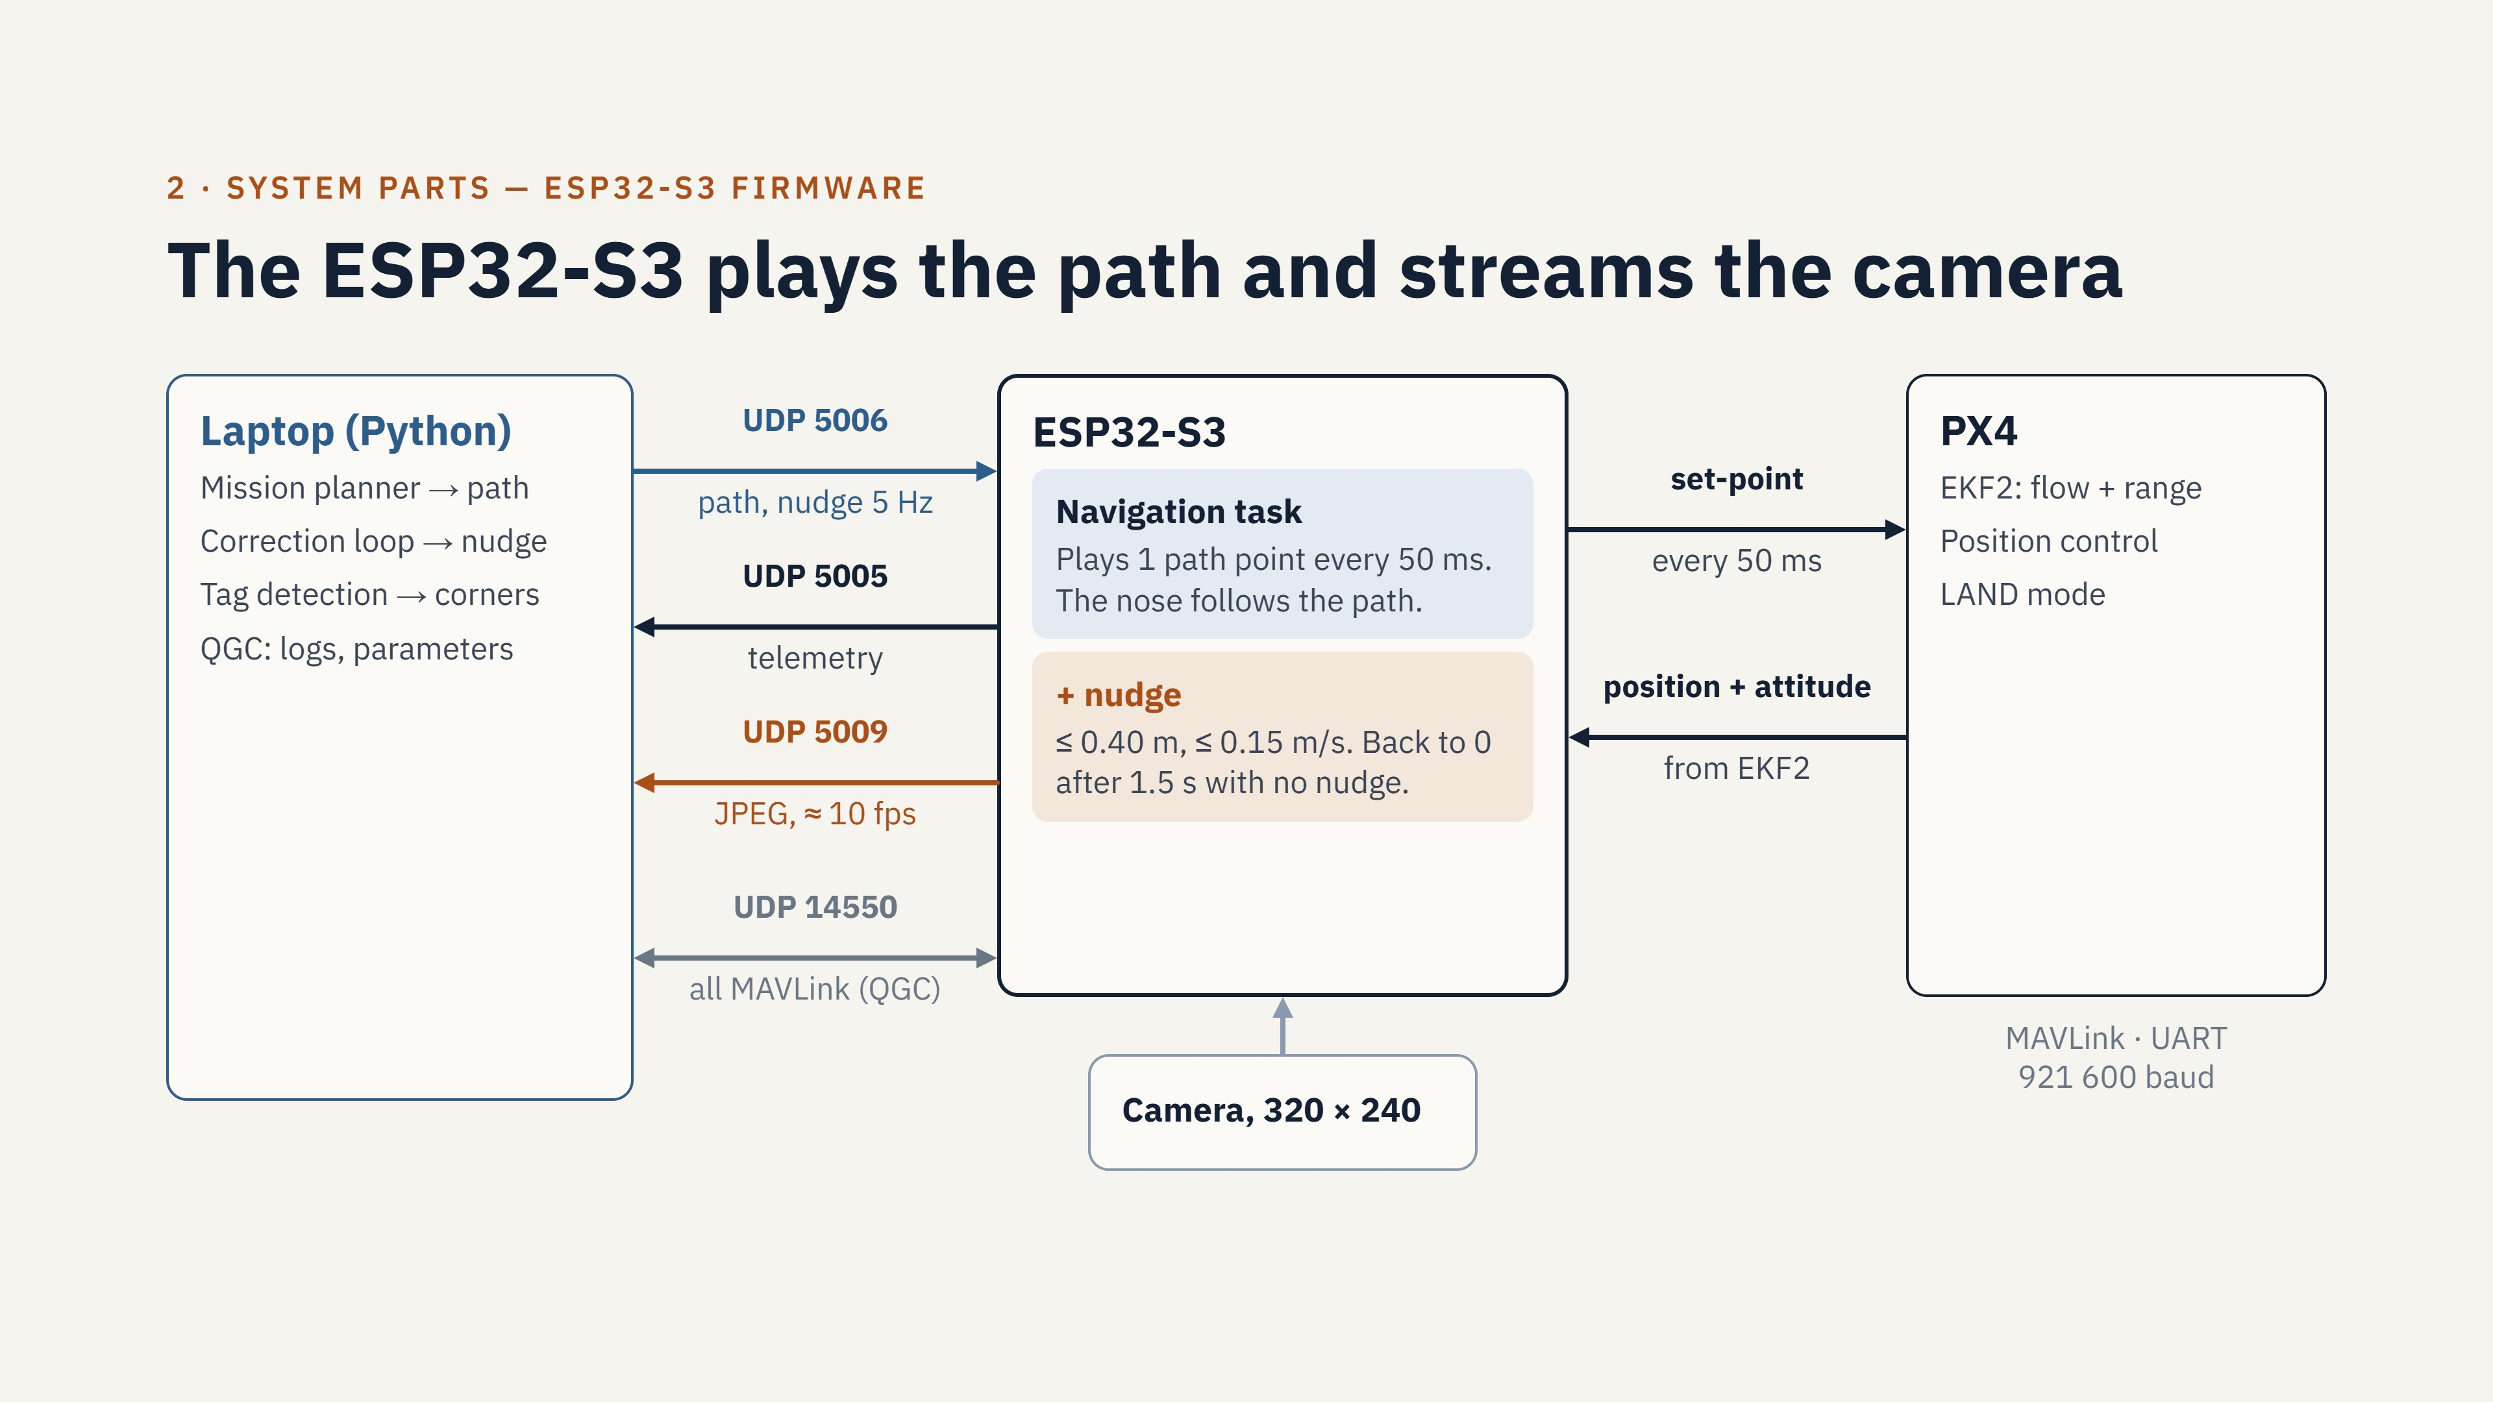
Notes:
The ESP32-S3 is the bridge between the laptop and PX4. It talks to PX4 with MAVLink on a serial line at 921600 baud. It talks to the laptop with UDP over Wi-Fi. Port 5005 carries the telemetry to the laptop. Port 5006 carries the commands from the laptop: the path, the start, the nudges and the camera keep-alive. Port 5009 carries the camera frames. Port 14550 carries all PX4 MAVLink messages to the laptop and to QGC. The navigation task reads the next path point every 50 ms. It sends the position and the velocity to PX4. The nose follows the direction of the path. If the laptop stops the nudges for 1.5 s, the offset goes back to zero.

Slide 5
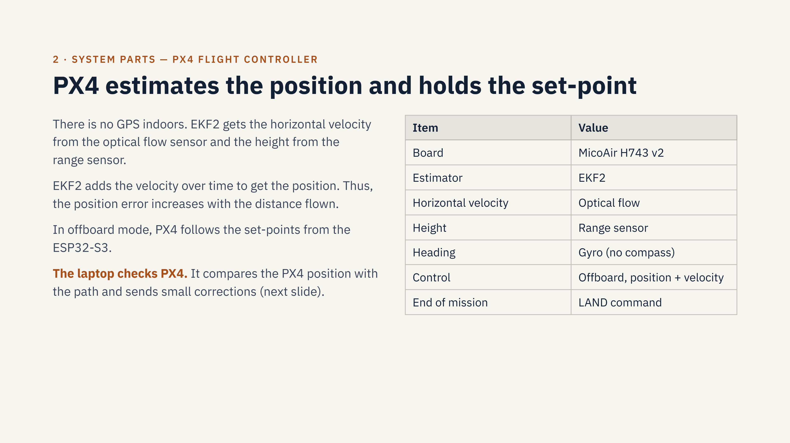
Notes:
PX4 does not know where the tags are. It only follows the set-points. The position from EKF2 comes from the optical flow. Thus, the position error increases during the flight. The home tag check before the landing removes this error. The PGO removes it from the tag map after the flight.

Slide 6
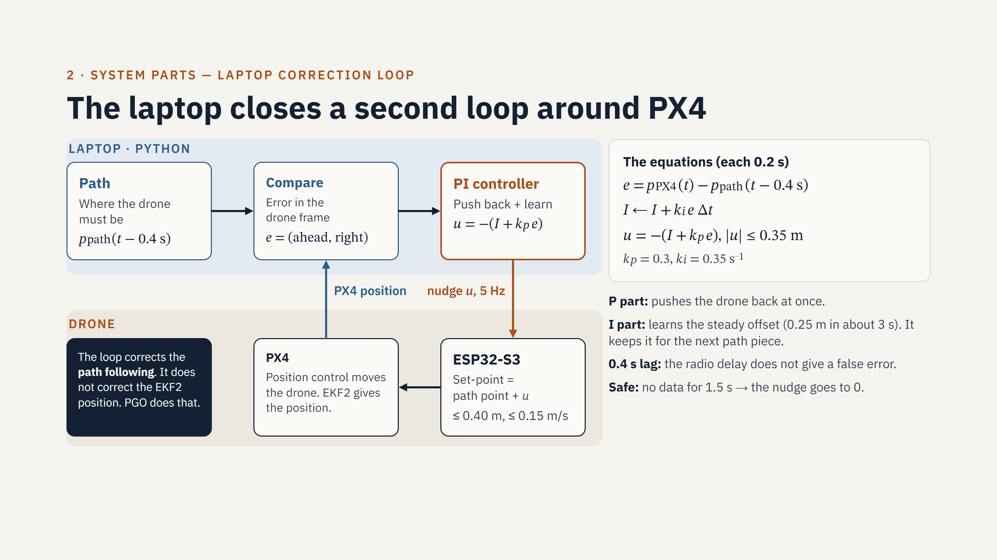
Notes:
PX4 follows the set-points, but it does not follow them exactly. Without this loop, the drone stayed 0.2 to 0.3 metres off the path, and PX4 did not pull it back. The laptop compares the PX4 position with the path, 5 times each second. It uses the path point from 0.4 seconds earlier, because the radio and PX4 have a delay. The P part pushes back at once. The I part learns the steady offset and keeps it. The laptop sends the nudge to the ESP32-S3. The firmware adds the nudge to each set-point. The firmware also has limits: 0.40 metres and 0.15 metres per second. If the nudges stop for 1.5 seconds, the nudge goes back to zero. Note: the loop uses the PX4 position. Thus, it makes the path following better, but it does not correct the PX4 position error. The home tag check and the PGO correct that error.

Slide 7
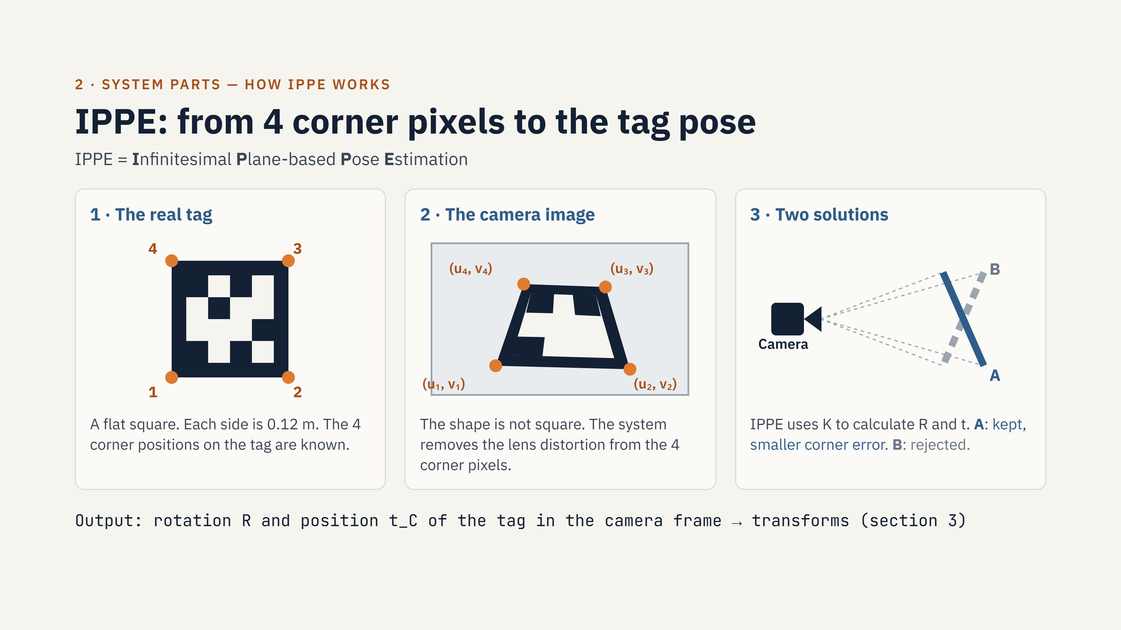
Notes:
IPPE means Infinitesimal Plane-based Pose Estimation. The tag is a flat square with a known size. The camera gives the 4 corner pixels. The system removes the lens distortion from these pixels. IPPE compares the real square with the shape in the image. It uses the camera matrix K. It calculates the rotation and the position in one step. It does not need a first estimate. A flat square can give two solutions. IPPE calculates the two solutions. It keeps the solution with the smaller corner error.

Slide 8
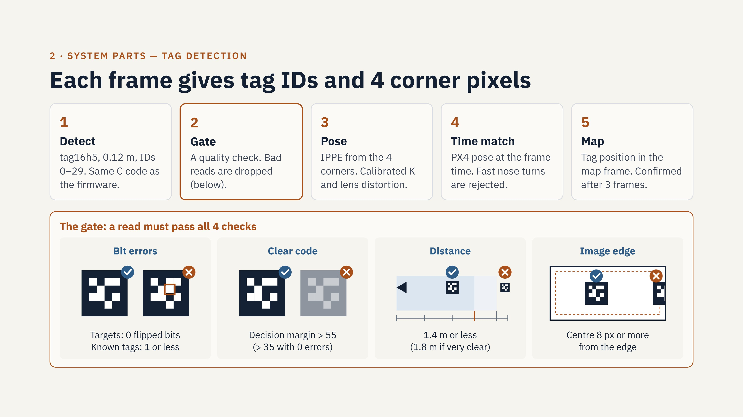
Notes:
The laptop detects the tags. The detector is the same C code that the firmware uses. Each detection gives the ID and the 4 corner pixels. The gate is a quality check. It removes bad reads. A read must pass 4 checks. First, the bit errors: a target must have 0 bit errors, and a known tag can have 1. Second, the decision margin: this shows how clear the code is. It must be more than 55, or more than 35 with 0 bit errors. Third, the distance: 1.4 metres or less, or up to 1.8 metres if the margin is 100 or more. Fourth, the tag centre must be 8 pixels or more from the image edge. The tag16h5 family has only 30 codes. Thus, a partly covered tag can give a wrong ID. For this reason, a target must have 0 bit errors. From 9 November, the pose uses the calibrated camera matrix and the lens distortion.

Slide 9
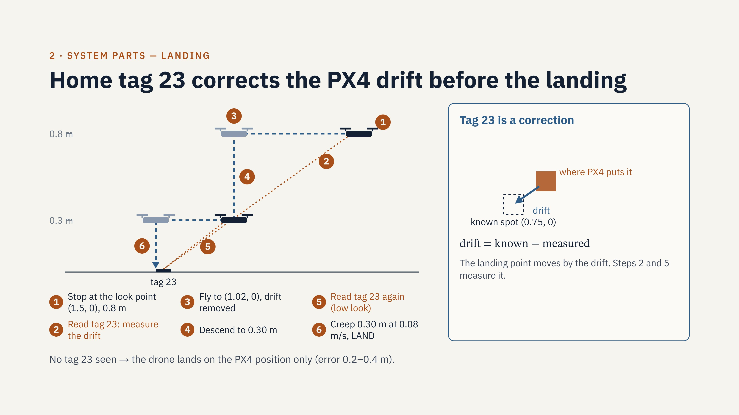
Notes:
Tag 23 is a correction, not a target. Its position is known. When the drone sees it, the difference between the known position and the PX4 position is the drift. The landing uses tag 23 two times. The first read is at 0.8 m height. The second read is at 0.30 m height. Each read gives the difference between the PX4 position and the true position. The drone then flies to the landing spot with this difference removed. If tag 23 is not visible, the drone lands on the PX4 position. Then the error can be 0.2 to 0.4 m.

Slide 10
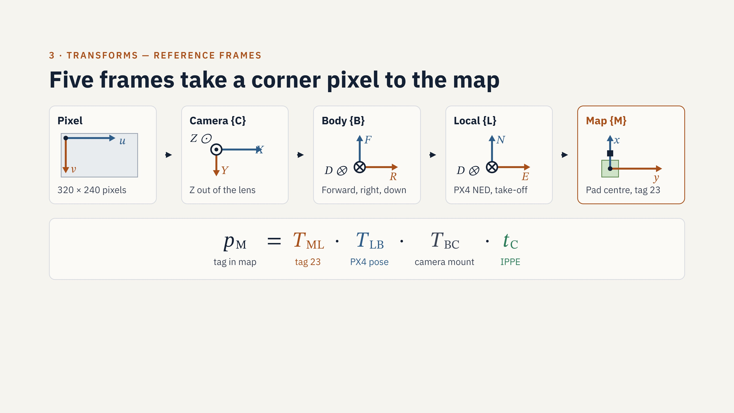
Notes:
Each tag sighting goes through these five frames. IPPE gives the tag position t_C in the camera frame. The camera mount transform T_BC gives the position in the body frame. The PX4 pose T_LB gives the position in the local frame. Tag 23 sets the map frame after the take-off, with T_ML. The live code uses only the yaw from PX4. At low speed, roll and pitch are a few degrees. The PGO uses the full attitude.

Slide 11
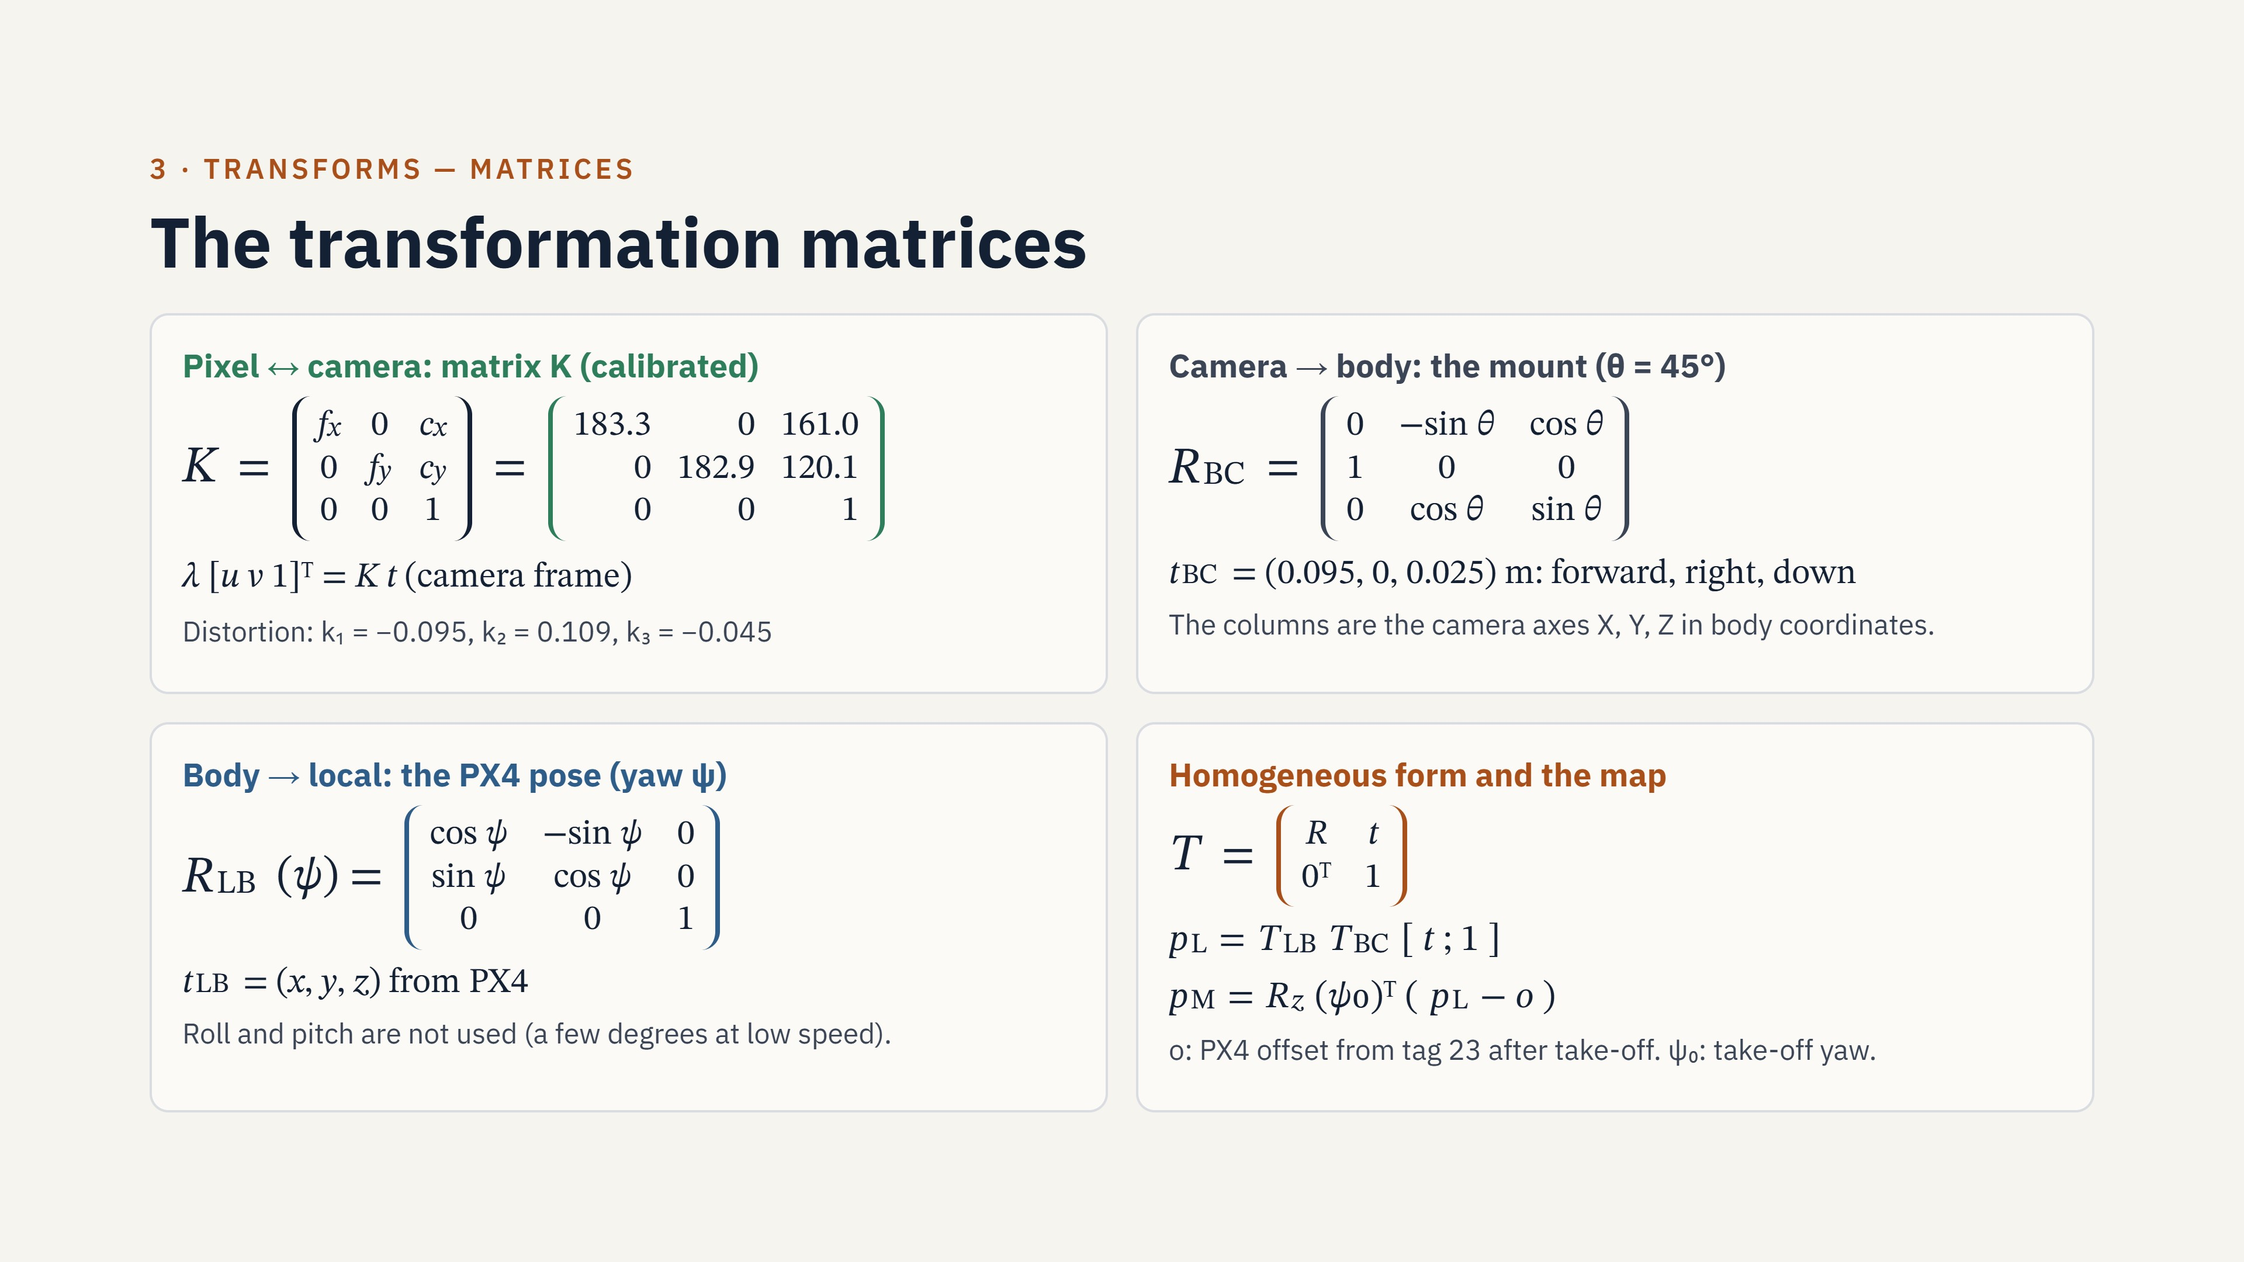
Notes:
K comes from the calibration of 29 chessboard images. The re-projection error is 0.30 pixels. R_BC has the camera axes in body coordinates as its columns. The camera points 45 degrees down. R_LB turns the body frame by the yaw angle from PX4. The homogeneous matrix T puts the rotation R and the translation t in one 4 by 4 matrix. The last line moves the result into the map frame. The map frame has its origin at the pad centre.

Slide 12
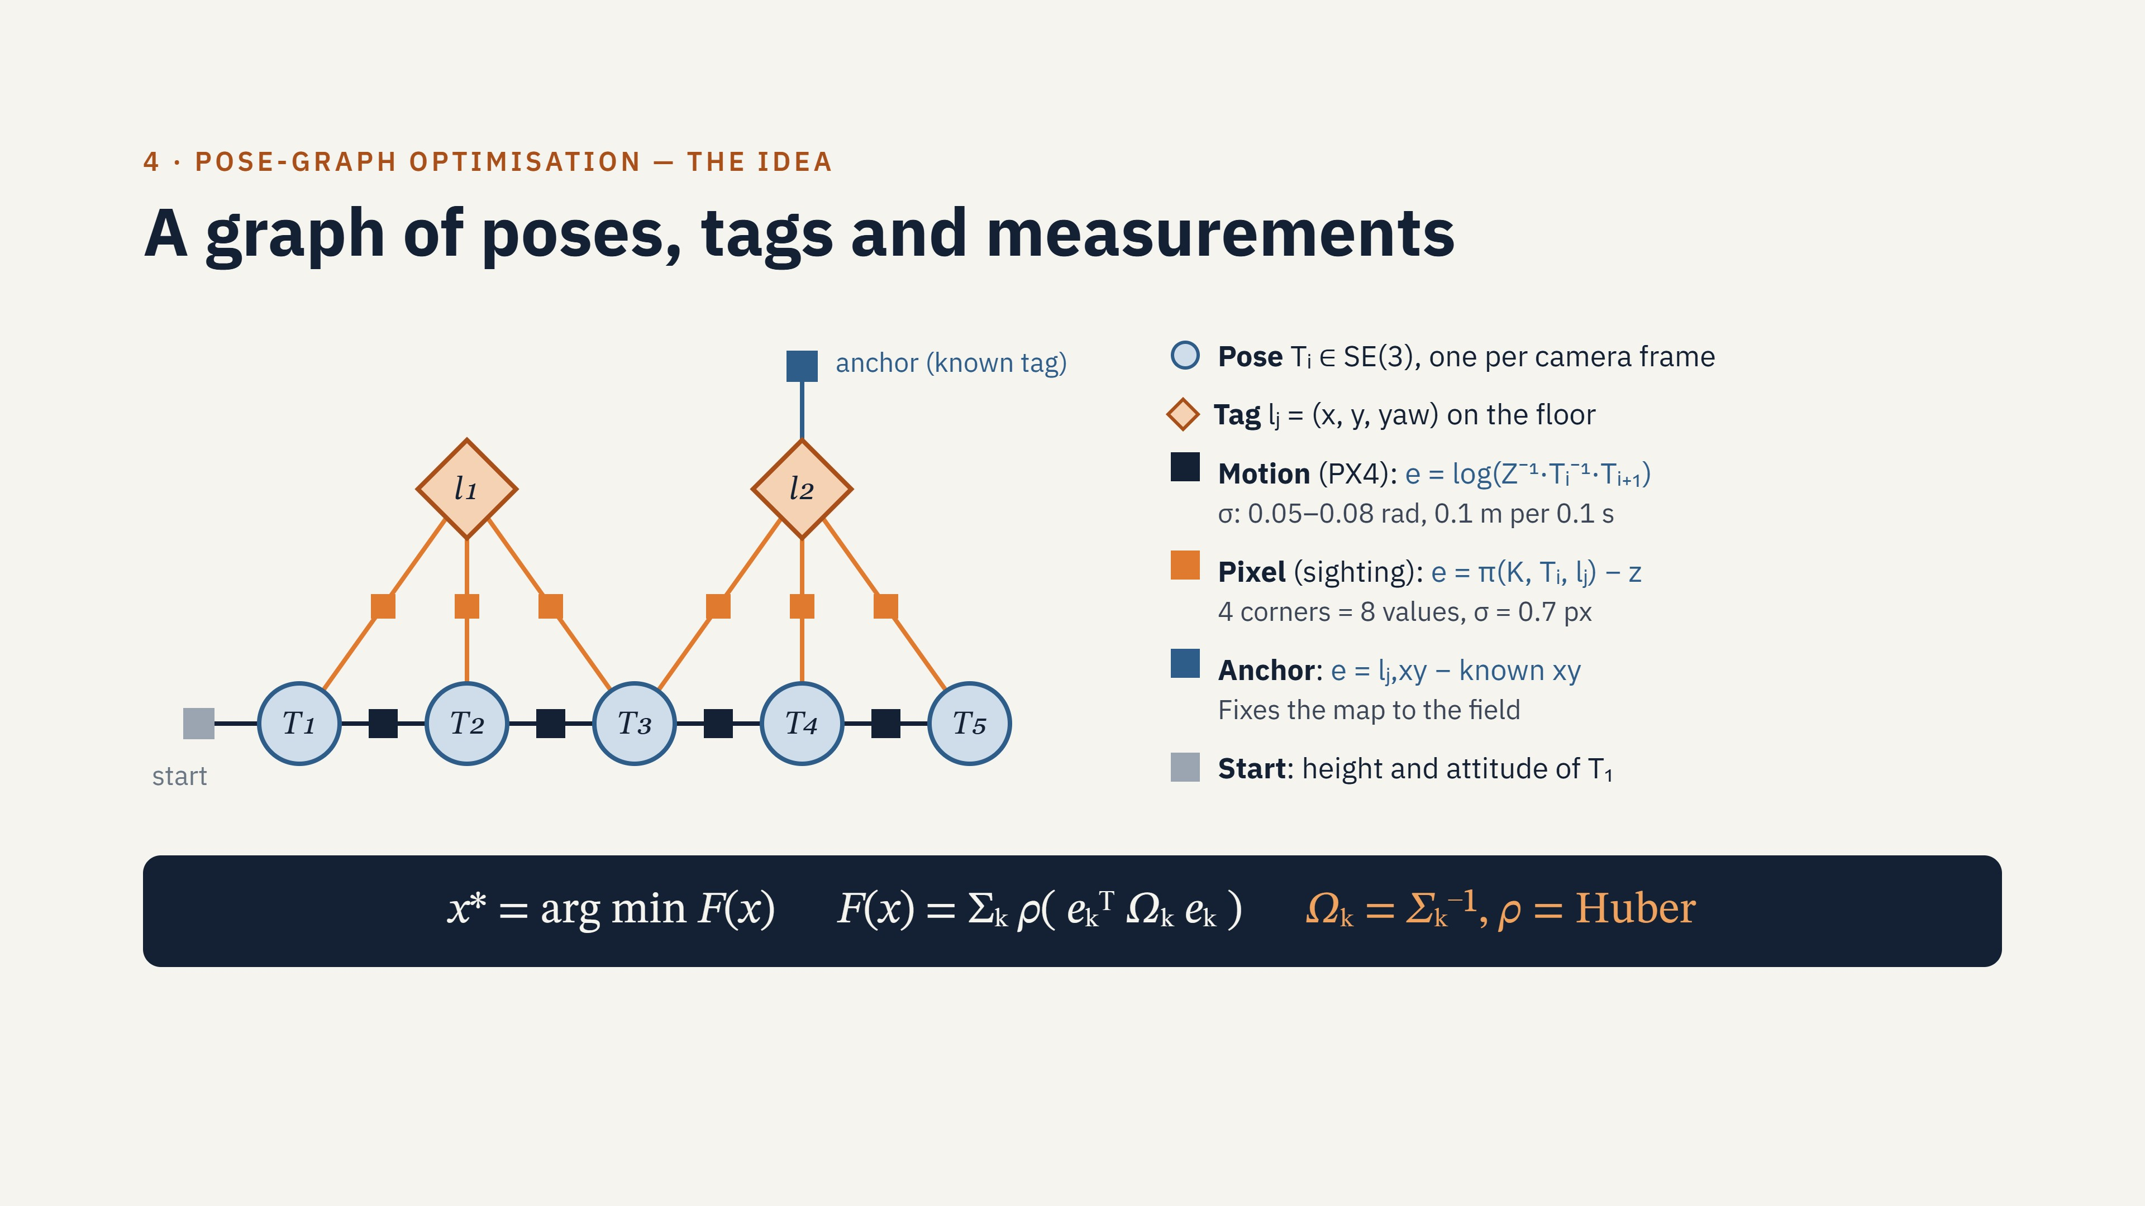
Notes:
The optimisation runs after the landing. The circles are the drone poses. The diamonds are the tags. The squares are the measurements. A dark square is a PX4 motion between two poses. An orange square is one tag sighting: the 4 corners, projected into the image, must agree with the measured corners. A blue square fixes a known tag to its surveyed position. The solver finds the poses and the tags that give the smallest total cost F.

Slide 13
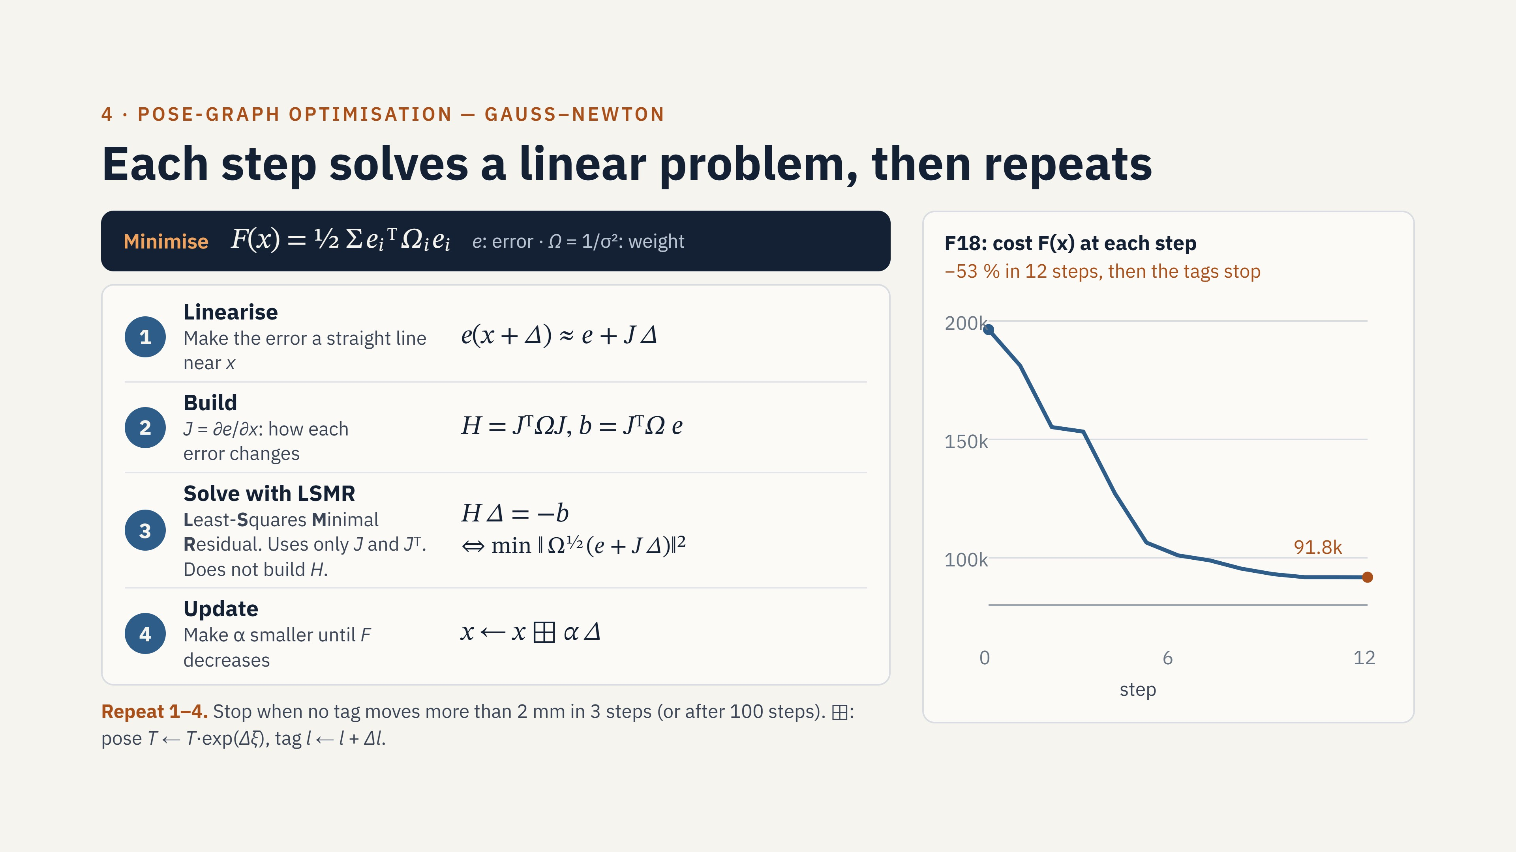
Notes:
The next two slides show one small example with numbers. Gauss-Newton replaces the non-linear cost with a linear model near the current estimate. The normal equations give the step. The Jacobian is large and sparse: most entries are zero. Thus, we use LSMR. LSMR means Least-Squares Minimal Residual. It is an iterative solver. It uses only products with J and J transpose, and it does not build H. This uses less memory and is more stable. We scale the columns because pixels, metres and radians have different sizes. The Huber weights reduce the effect of large residuals. The line search accepts a step only if the cost decreases. In run F18, the cost decreased by 53 percent in 12 steps. Then the tags did not move, and the solver stopped.

Slide 14
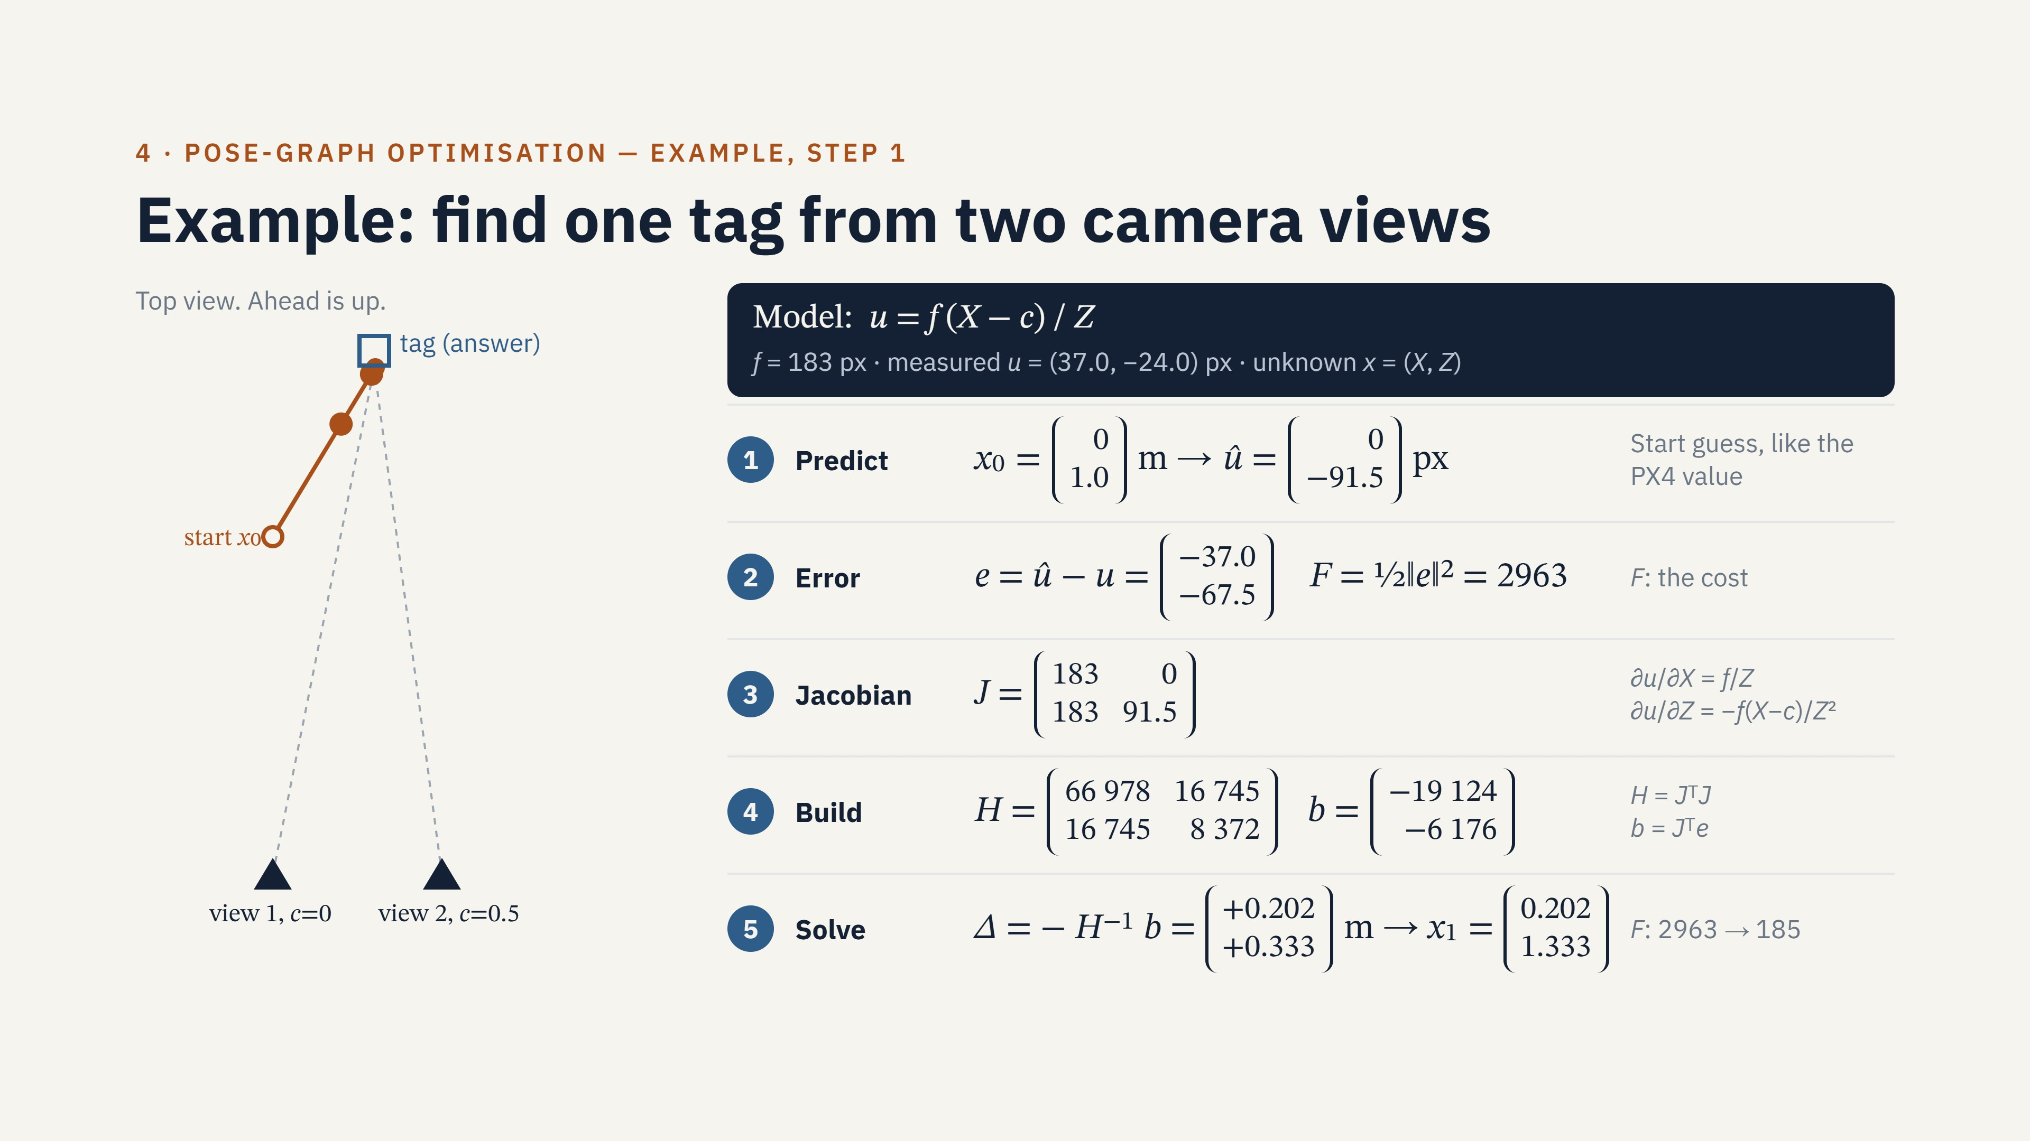
Notes:
This is a small example of the same method. The camera sees one tag from two positions, 0.5 metres apart. The unknowns are the tag position X and the distance Z. The measured pixels are 37.0 and minus 24.0. We start at X equal to 0 and Z equal to 1 metre, like the PX4 start value. Step 1: we predict the pixels. Step 2: we subtract the measured pixels to get the error. Step 3: the Jacobian shows how each pixel changes when X or Z changes. Step 4: we build H and b. Step 5: we solve for the step and add it. The cost decreases from 2963 to 185. Both views have the same weight, 1 over 0.7 pixels squared. Thus, the weight cancels in the step and we do not show it.

Slide 15
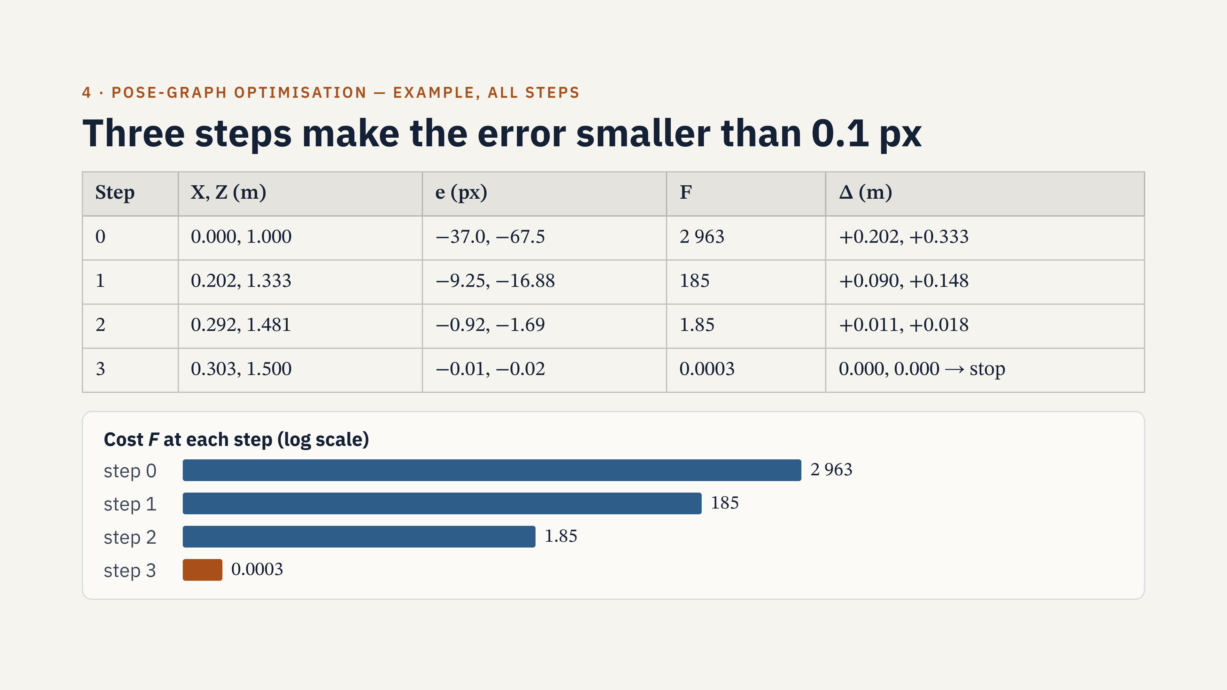
Notes:
This table shows all the steps of the example. Each row is one Gauss-Newton step. The first step is large, but it does not go to the answer, because the line model is not good far from the answer. After that, the error becomes 10 times smaller, then 80 times smaller. After step 3, the step is zero and the method stops. The answer is 0.303 metres, not 0.300, because the measured pixels have noise. The real PGO uses the same steps, but with many more unknowns and errors.

Slide 16
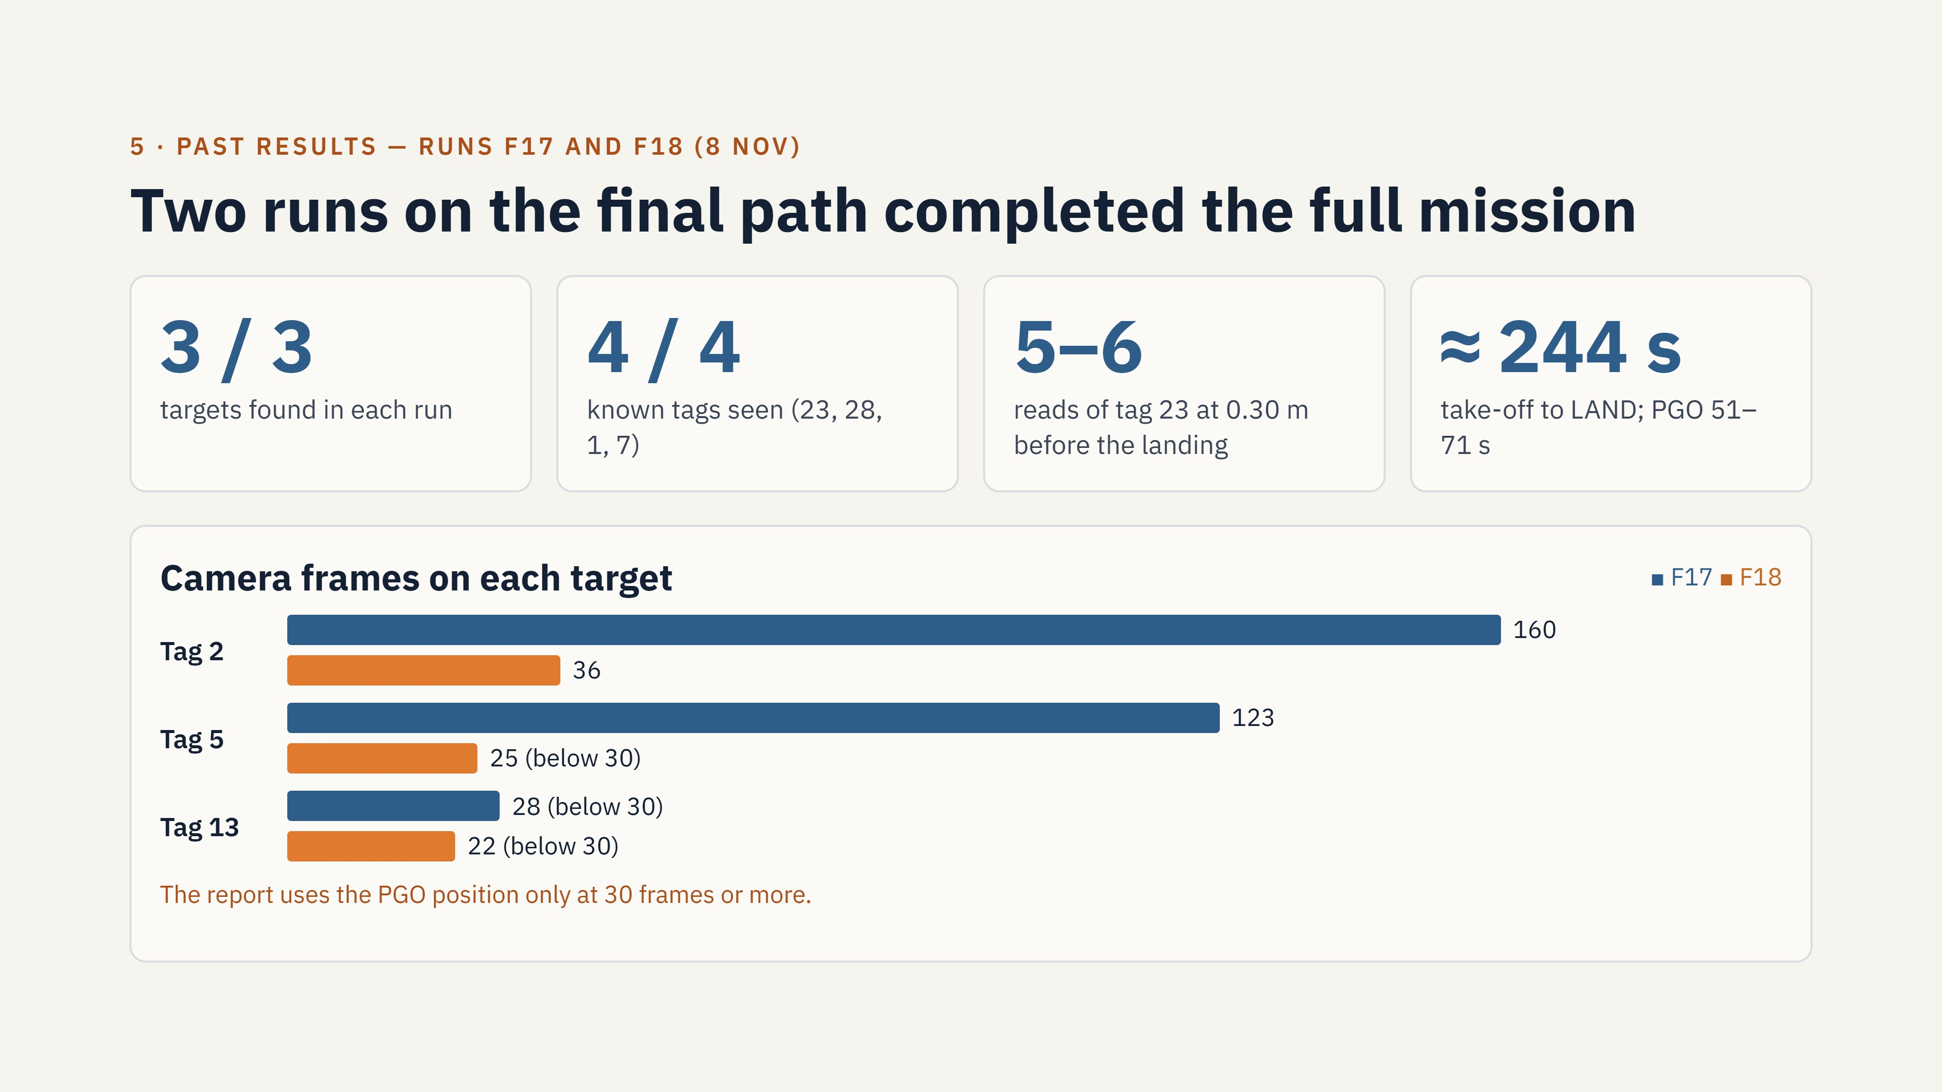
Notes:
F17 and F18 used the locked path. Both runs found the 3 targets and all 4 known tags. Both runs read tag 23 at 0.30 m height before the landing. The bars show the number of camera frames on each target. F18 got fewer frames, and tag 13 got less than 30 frames in both runs.

Slide 17
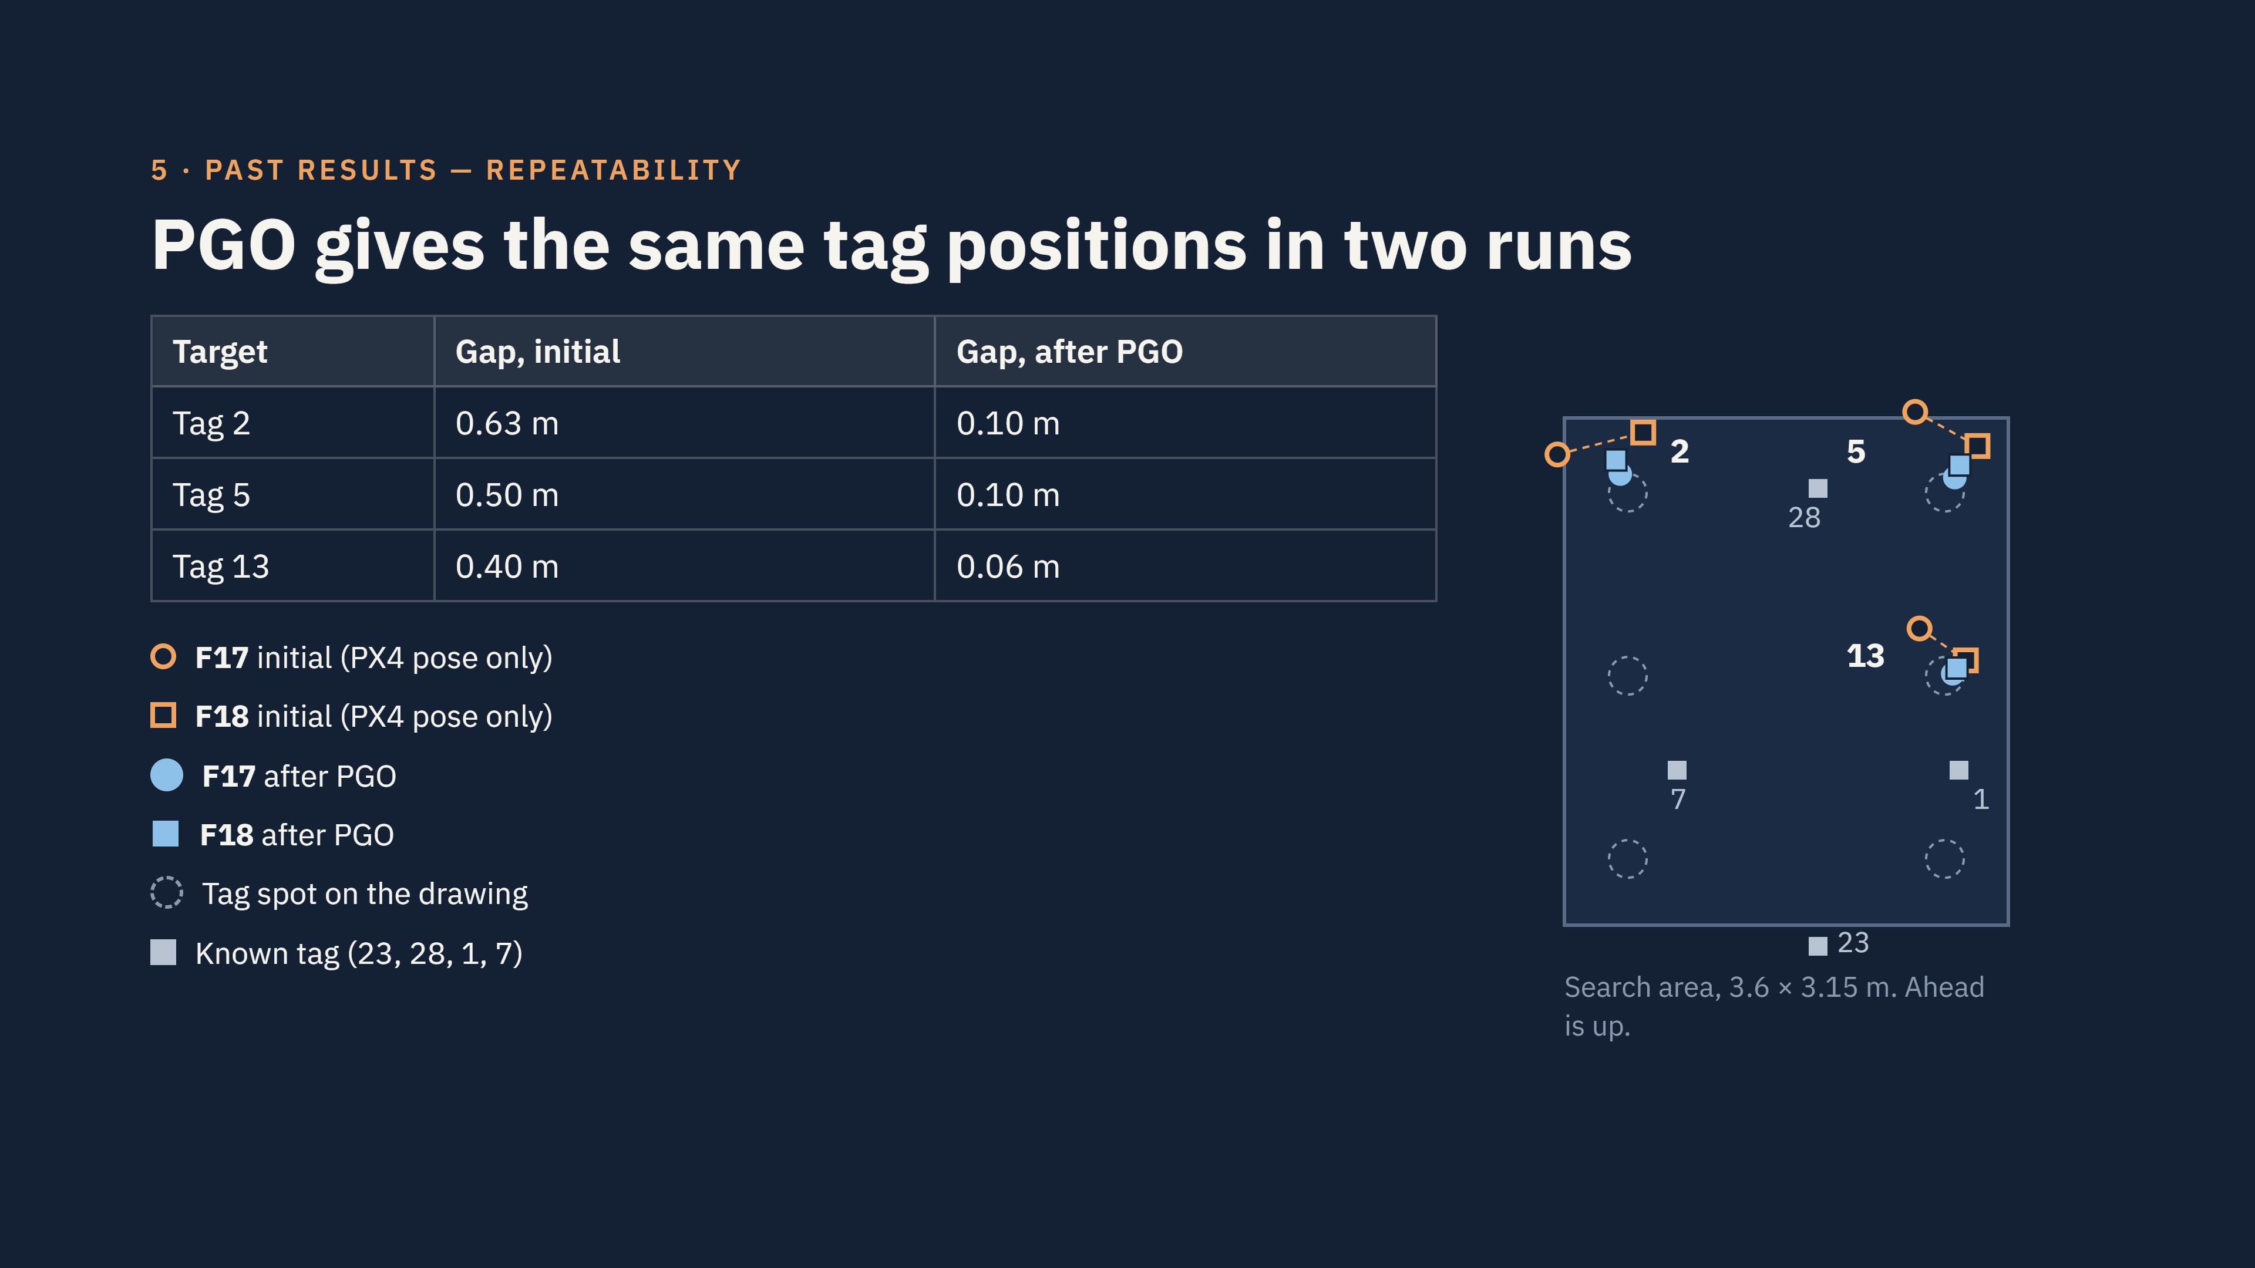
Notes:
This slide shows the main result. We flew the same path two times. The orange rings are the initial tag positions. They changed by up to 0.63 metres between the runs. The blue dots are the positions after PGO. They changed by 0.10 metres or less, and they are near the tag spots on the drawing. In these runs, all 4 known tags were fixed in the optimisation. Thus, the repeatability is the real test.

Slide 18
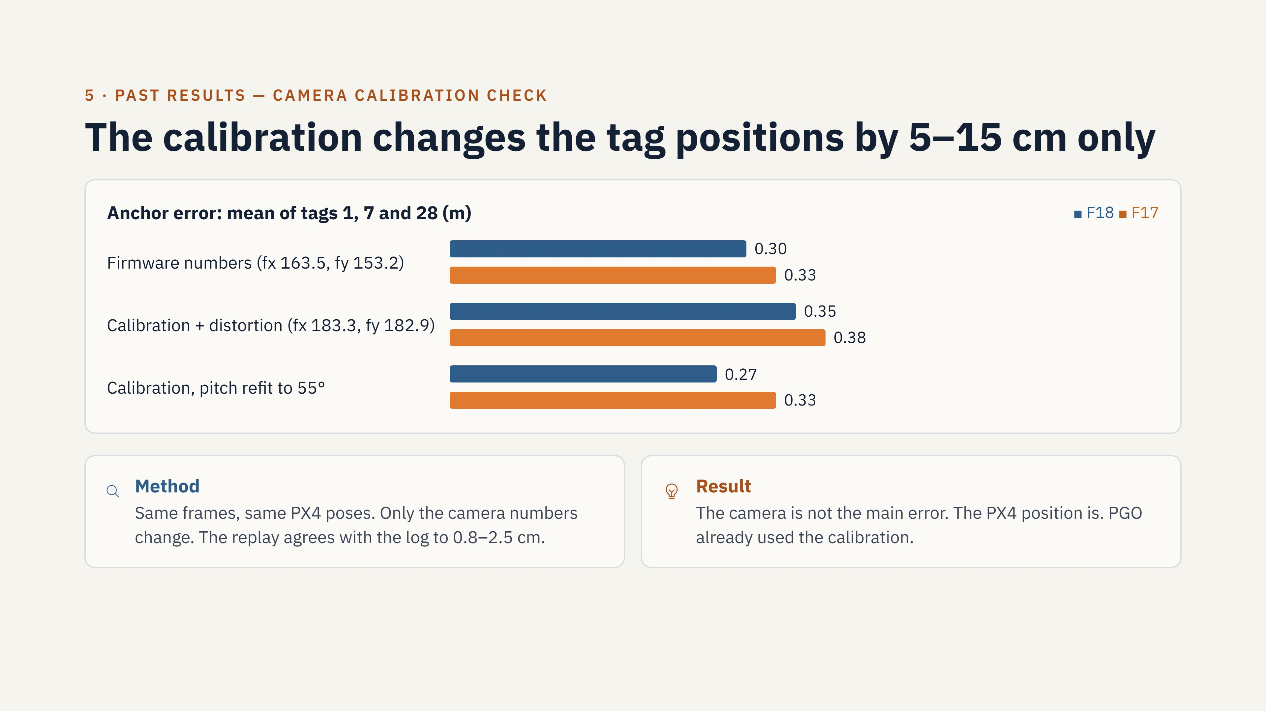
Notes:
Before 9 November, the live code used the camera numbers from the firmware. The calibration gives a focal length 12 to 19 percent larger. We replayed two runs with both sets of numbers. The bars show the mean anchor error. The errors did not become smaller. Thus, the large errors come from the PX4 position. The live code now uses the calibration, because it is correct. We keep the camera pitch at 45 degrees.

Slide 19
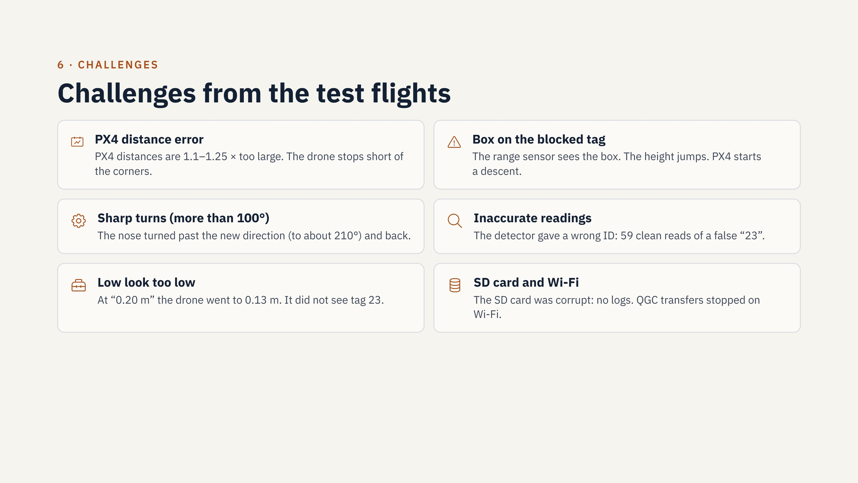
Notes:
These are the main problems from the test flights. The largest problem is the PX4 distance error. PX4 gets its velocity from the optical flow sensor. This PX4 version has no parameter to correct the flow scale. The box on the blocked tag is a problem for the range sensor. The other problems have fixes in the current code or in the procedure.

Slide 20
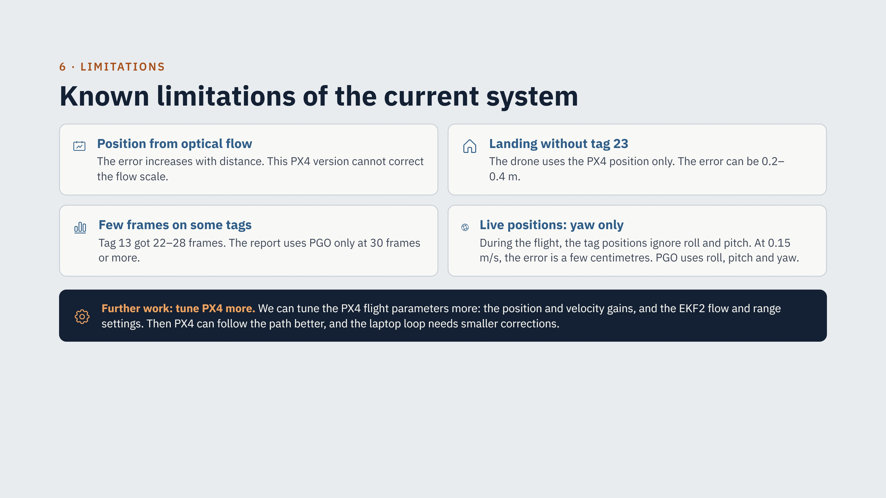
Notes:
These limits remain in the current system. The largest limit is the optical flow position. The PGO reduces its effect on the map, but not during the flight. The landing needs tag 23. We can also tune the PX4 flight parameters more. Better position and velocity gains can make the path following better. Better EKF2 settings for the optical flow and range sensors can make the position estimate better. Then the laptop correction loop needs smaller nudges.

